Slide 1
DECEMBER 2022 SYNODAL UPDATE
Welcome to our Advent Newsletter
In this edition, you will find an update on matters ‘Synodal’, past, present and future.
And on page 2…. YOUR help is needed!
I would also be very grateful for any feedback on what has been happening in your Parishes and other communities, so that we can share good practise. For this, and any other thoughts and comments, email synodfeedback@prcdtr.org.uk
With every blessing for Advent.
Fr Paul Keys (Diocesan Synodal Co-Ordinator)
The Synod 2021-2024
Holy Spirit our way to truth guide the church in the midst of turmoil and chaos in the world of uncertainties.
Help each person to be bond in the unity of love and peace, fill everyone in the church with abundant joy in times of crisis, suffering and grief .
We pray for synod of synodality be a new Pentecostal experience in building the church and the zeal to evangelize the human race.
Mother Mary hold our hands to be united with your children entrusted by Jesus.
Amen
John Prakash, Abu Dhabi United Arab Emirates
Yes, 2024!
In October Pope Francis announced
that the ‘Ordinary Assembly of the
Synod of Bishops’ taking place to
discuss and discern the journey the
whole Church has been taking over
the past year will now take place in two sessions. October 2023 and October 2024.
This extension is an opportunity, as Pope Francis said:
‘To foster an understanding of synodality as a constitutive dimension of the Church, and to help everyone to live it in a journey of brothers and sisters who bear witness to the Gospel.’
This is a really positive development and enables time for the Bishops, and us all, to listen to where the Spirit is leading us.
In the meantime, many Parishes have gathered together to discuss our Diocesan and/or National Syntheses. If this has not happened in your community, then why not consider doing so?

Slide 2
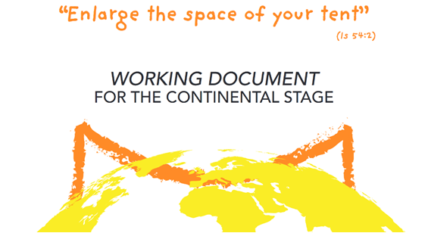
Working Document for the Continental Stage
This document, the fruits of discernment from across the world, was published last month. It makes a fascinating read and tool for prayer and discernment. It is available at:
WORKING DOCUMENT FOR THE CONTINENTAL STAGE (synod.va)
Please share this news/link with others.
The image of a tent is central to the document and the call to ‘Enlarge the space of your tent’. As a diocese we have been asked to feedback to the Bishops Conference so that this can, in turn, be fed back to inform the final document which will form the basis of discernment for the Bishops meetings in October 2023/24.
Help Needed! I would like to invite you all to spend some time reading, reflecting, and answering the questions posed in the document (section 106). The questions could also be summed up as asking us:
What you thought about the document?
What you thought was important/wrong/missing?
What are the most important elements in the document to take forward?
If you could send me your comments by Christmas please, as the deadline is in January.
Next Steps…
As a Diocese, we will continue our synodal journey together in several different ways including:
Newsletters sharing updates on the global Synod and what is happening in our own Diocese.
As parishes looking at how we can build stronger communities which welcome others in, and as parishes together, sharing what we are doing.
Exploring ways for our schools to join in the synodal journey.
More information about all of this will follow in the New Year.
And if you have any ideas and suggestions how we can make this happen,
please contact synodfeedback@prcdtr.org.uk
Lord, you have gathered all your people in Synod.
We give you thanks for the joy
experienced by those who decided to set out
to listen to God and to their brothers and sisters during this year
with an attitude of welcome, humility, hospitality and siblinghood.
Come Holy Spirit: may you be the guide of our journey together.
From the Working Document for the Continental Stage

