Slide 1
MODERN SLAVERY IN RURAL AREAS

Slide 2
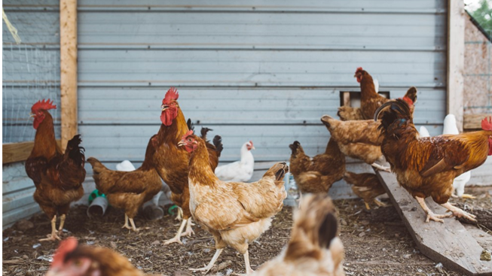
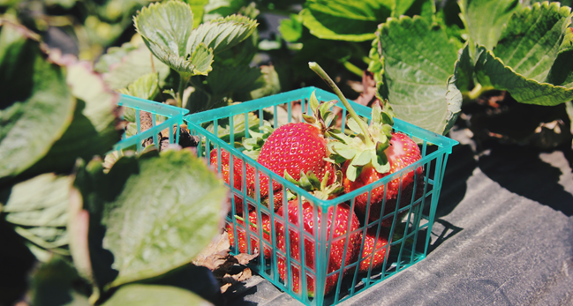
RURAL or urban?
A rural area is not just fields…

Slide 3
UNDERREPORTING
Modern slavery in rural areas is underreported.
Percentage comparisons between rural and urban areas evidence this
Why?
(i)difficulties with observation
(ii)creation of partnerships
(iii)it doesn’t happen here?

Slide 4
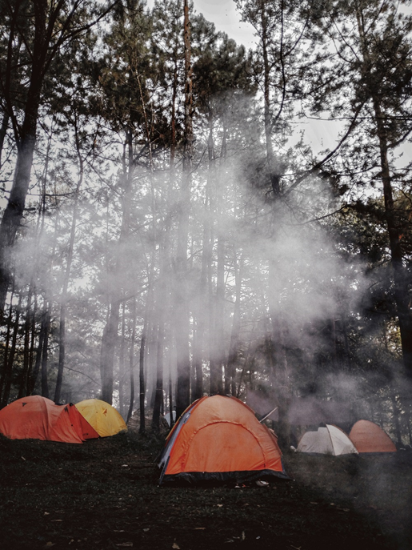
What is modern slavery?
Modern slavery is a hidden crime.
There are an estimated 136,000 victims in the UK and 10,627 potential victims found in 2019.
Modern Slavery is an umbrella term for all forms of slavery, trafficking and exploitation.
Deception- this is at the core of the crime as traffickers make false promises to victims.

Slide 5
What is modern slavery?
Traffickers target those who are vulnerable.
Victims may be offered jobs and opportunities for a better life.
These offers turn out to be a lie and instead they are forced to work in difficult and degrading conditions, with little or no pay.
They become trapped in the situation and are controlled by their trafficker, often through threats, violence or a fear of authorities.
Modern slavery knows no borders and people of all ages, genders, and races can become victims.

Slide 6
Modern slavery in rural areas
Here are some of the key sectors at risk of modern slavery in rural areas:
agriculture
horticulture
equestrian
food processing, packing and
manufacture
hospitality and tourism
sex work
hand car washes
care sector- home care and residential care

Slide 7
How can the church help?
We believe that slavery can only be eradicated at a community level
Churches are part of their community
Churches are frequently in contact with the most vulnerable
Churches have a convening power

Slide 8
What can we do?
Learn to spot the signs:
Modern slavery could be happening in our local areas, so it important to be able to spot the signs.
Download a card for your wallet from The Clewer initiative website that has the signs to remember:
www.theclewerinitiative.org/resources
‘Slavery-proof’ our church projects:
Include training on modern slavery for volunteers at food banks or homeless shelters and other work involving vulnerable people.

Slide 9
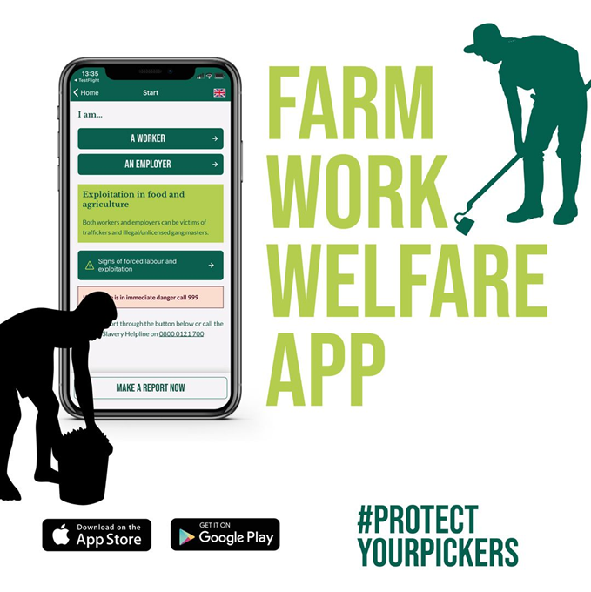
Farm work welfare app
The following link contains resources for the Farm Work Welfare App to be shared on social media:
https://www.dropbox.com/sh/k6fz4devwx77bai/AAC0c4s3m5DgPkgTautFn91ma?dl=0

Slide 10
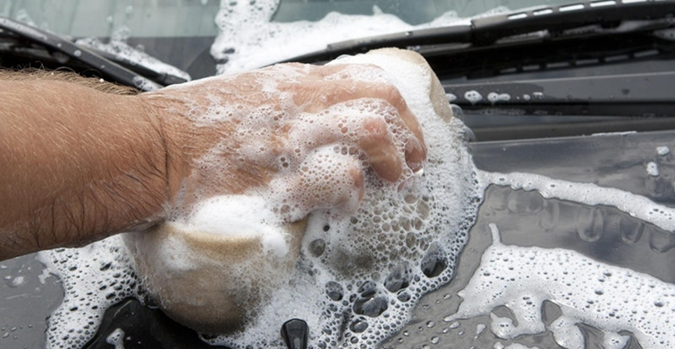
The safe car wash app
Estimated 19,000 unregulated hand car washes in the UK.
Many unregulated sites are suspected of being used for people trafficking and/or exploitation.
Download the Safe Car Wash App to report concerns you might have when using hand car washes.

Slide 11
Any questions?
What to do if you suspect someone is a victim of modern slavery:
In an emergency call 999
Report concerns to the Modern Slavery Helpline: 08000 121 700
Sign up to The Clewer Initiative newsletter at: http://eepurl.com/cQfZYT

