Slide 1
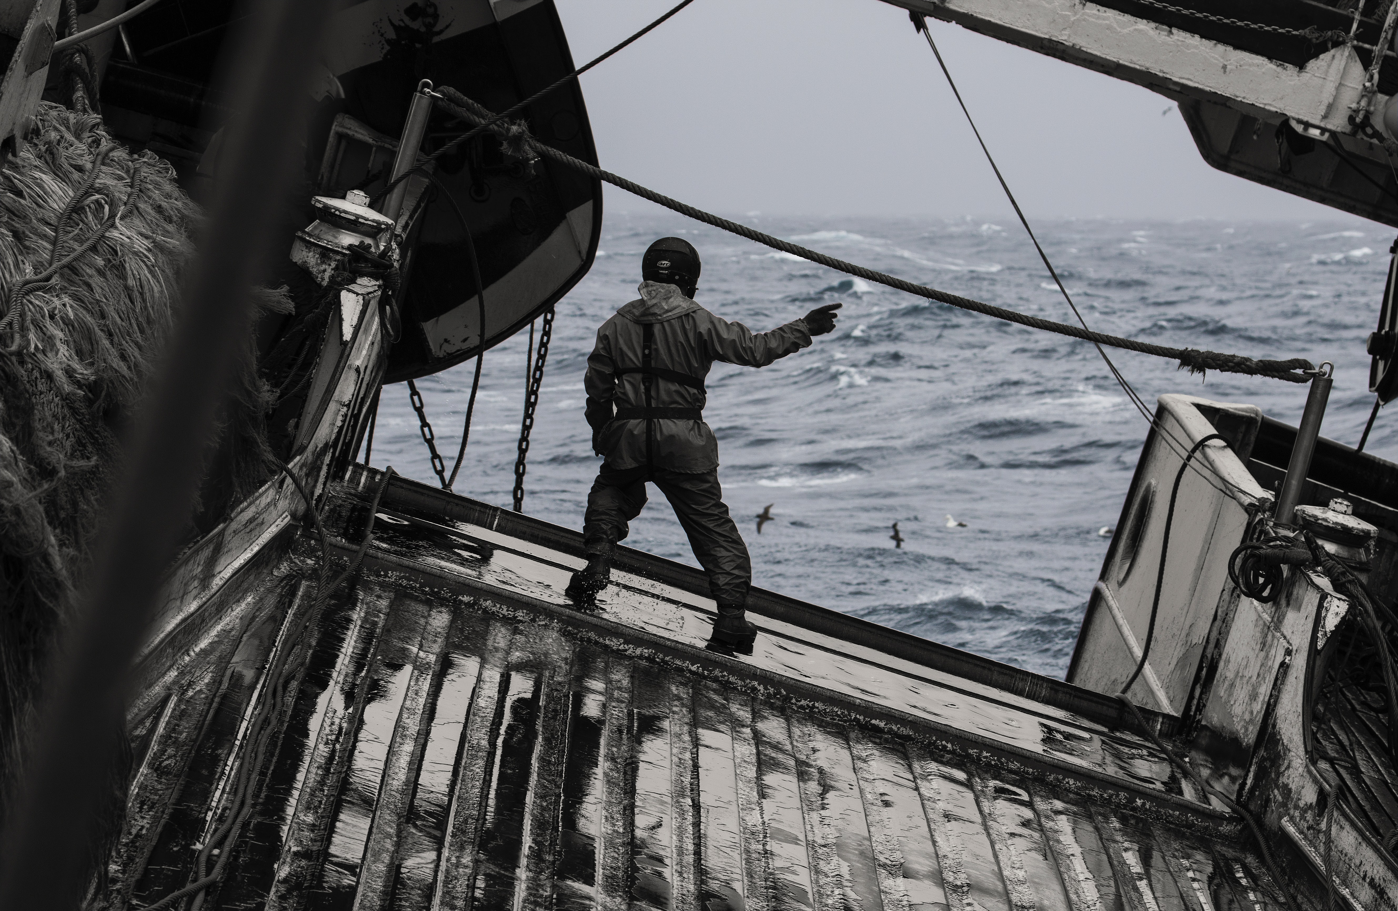

Slide 2
APOSTLESHIP OF THE SEA/STELLA MARIS
Stella Maris is the Catholic Church’s maritime welfare agency .
We provide practical and pastoral care to all seafarers in hundreds of ports around the world.
We have over 1,000 port chaplains and volunteers worldwide visiting 70,000 ships per annum.
It is estimated about a third of all seafarers are Catholic, with many coming from the Philippines and Catholic areas of India.

Slide 3
Modern Slavery
Isolation, abandonment, trafficking: These are some of the issues facing the estimated 1.5 million seafarers and fishermen around the world who are responsible for 90 percent of global trade and providing over 110 tons of seafood for the world’s table.
Seafarers and fishermen are vulnerable at the best of time . The lives that they lead are largely invisible ,and therefore they can all too easily fall prey to those who would chose to exploit or abuse them.

Slide 4
Modern Slavery – it’s closer than you think

Slide 5
Modern Slavery – changing the system
There is a need for a coordinated approach between the Church and relevant public and private agencies to close the loopholes that allow forced labour to occur in the maritime and fisheries sector . Cardinal Bruno Ciceri (Stella Maris International Secretary)
Fishing slavery is very common in poorer countries . Young men and boys are forced into slavery at sea ,they are exploited and abused and often become injured or lose their lives at sea.

Slide 6
Modern Slavery
Unfortunately , it is not only poorer countries that abuse and exploit fishermen from overseas it happens here in this country .
Thankfully it is only a small percentage of the fishing industry that are involved in unscrupulous practices and this reflects badly on other companies who work within the law.

Slide 7
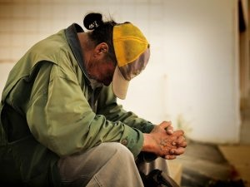
ROMERO’S STORY

Slide 8
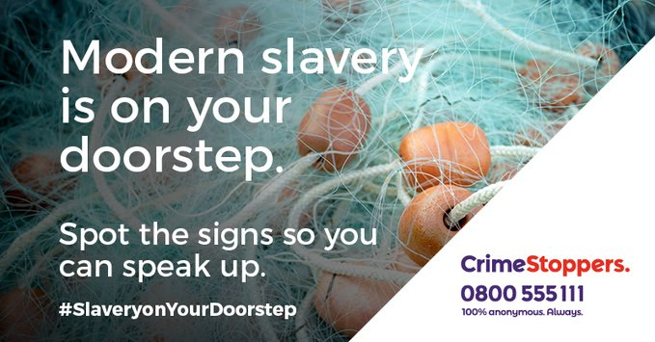
WHAT CAN WE DO?

