Slide 1
Translating principles into action Heather Buckingham
Notes:
Introduce myself
Outline of this talk: A bit about what we do, who we’re working with and the challenges that we’re responding to; Then reflect a bit on what it means to put principles into action, how do we do that?; Talk about some of the Christian values that underpin our work – where they come from and how we’re trying to put them into action.
As I describe what we do, I’d encourage you to listen out for clues as to what our values are, what some of the principles that inform our work might be – part way thought there will be an opportunity to offer your suggestions….

Slide 2
Together we can create a future without the need for food banks
We support a nationwide network of food banks and together we provide emergency food and support to people locked in poverty, and campaign for change to end the need for food banks in the UK.
Notes:
Together we can create a future without the need for food banks
We support a nationwide network of food banks and together we provide emergency food and support to people locked in poverty, and campaign for change to end the need for food banks in the UK.

Slide 3
Our Future
We don’t want to exist, and we don’t think we should need to. No charity can replace the dignity of buying your own food.
We need to ensure that everyone has enough money coming in to cover the cost of essentials, whether from secure work that pays real Living Wage or a benefits system that anchors people from being swept into poverty.
Notes:
Our Future
We don’t want to exist, and we don’t think we should need to. No charity can replace the dignity of buying your own food.
We need to ensure that everyone has enough money coming in to cover the cost of essentials, whether from secure work that pays real Living Wage or a benefits system that anchors people from being swept into poverty.

Slide 4
Our three pillars
We’re working to end the need for food banks in three key ways:
1.
Emergency food
Our network of food banks provides the best possible emergency food to people locked in poverty, supporting them in times of crisis.
2.
More than food
Our network helps people break free from poverty by providing additional support that resolves the crises they face.
3.
Creating change
We challenge the structural issues that lock people into poverty and campaign for long-term change to end hunger in the UK.
Notes:
Our three pillars
We’re working to end the need for food banks in three key ways:
Emergency food: Our network of food banks provides the best possible emergency food to people locked in poverty, supporting them in times of crisis.
More than food: Our network helps people break free from poverty by providing additional support that resolves the crises they face.
Creating change: We bring together high quality evidence from hundreds of communities across the UK to challenge the structural issues that lock people into poverty and to campaign for long-term change to end hunger in the UK.

Slide 5
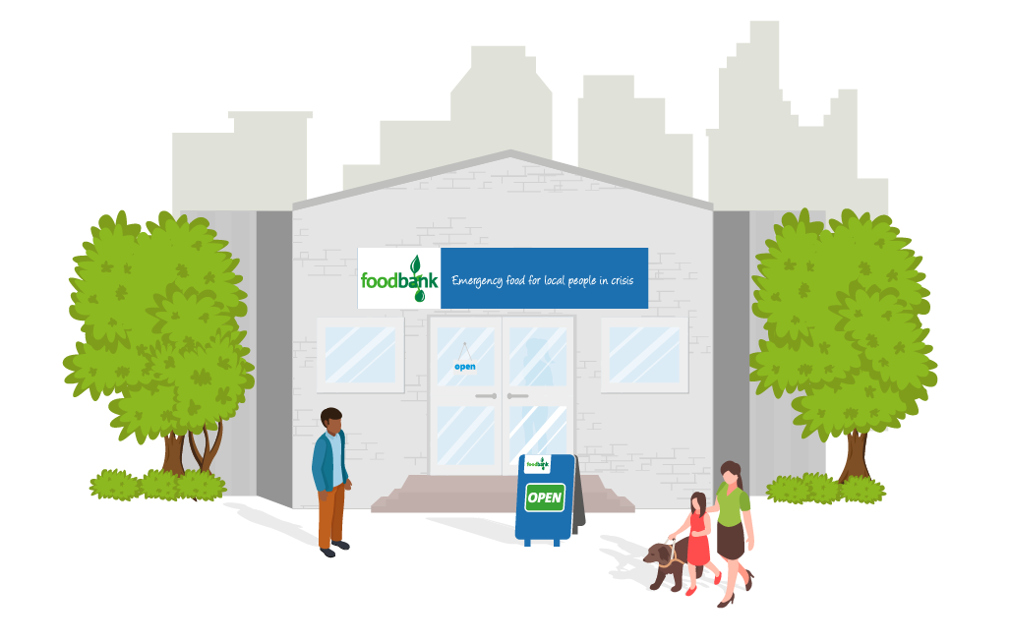
About our network of food banks
There are more than 1,200 food bank centres in our network - about two thirds of all food banks in the UK.
We support food banks to provide three days’ nutritionally-balanced emergency food to people in crisis, as well as support to help people resolve the challenges they’re facing, and ensure they do not need to use a food bank again.
Notes:
About our network of food banks
There are more than 1,200 food bank centres in our network - about two thirds of all food banks in the UK.
We support food banks to provide three days’ nutritionally-balanced emergency food to people in crisis, as well as support to help people resolve the challenges they’re facing, and ensure they do not need to use a food bank again.

Slide 6
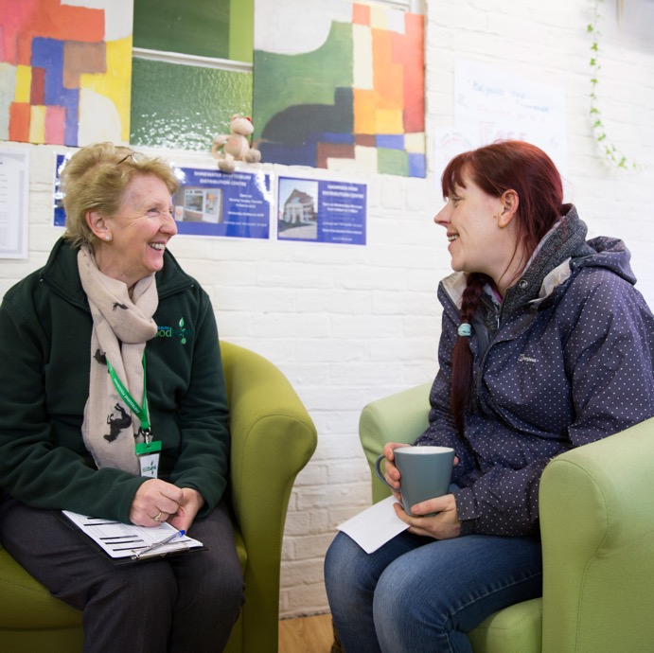
Referral process (how people access a food bank)
People are referred to food banks by external agencies and professionals - like health visitors, social workers, or Citizens Advice staff - if they are in crisis.
When they are referred, they are issued with a food bank voucher. When they bring this to their local food bank, they can receive a food bank parcel and compassionate, practical support.
Notes:
Referral process (how people access a food bank)
People are referred to food banks by external agencies and professionals - like health visitors, social workers, or Citizens Advice staff - if they are in crisis.
When they are referred, they are issued with a food bank voucher. When they bring this to their local food bank, they can receive a food bank parcel and compassionate, practical support.

Slide 7
The need
More than 14 million people in the UK are living in poverty, 4.5 million of these are children.
April 2018 - March 2019
1.6 million
19%
increase compared
with previous year
number of three-day emergency food supplies provided to people in crisis by food banks in the Trussell Trust network
73%
increase in the last five years
Notes:
More than 14 million people in the UK are living in poverty, 4.5 million of these are children.
Last year, food banks in our network gave out a record 1.6 million food bank parcels to people in crisis. That’s enough to feed the populations of Edinburgh, Cardiff, and Sheffield combined. This is a 19% increase on the previous year, and more than half a million of these parcels went to children.
In the last five years, food bank use in our network has increased by 73%. Year upon year, more and more people are struggling to eat because they simply cannot afford food.

Slide 8
South west
April 2018 - March 2019
132,510
three-day emergency food supplies provided to people in crisis by food banks in the Trussell Trust network in the South West of England
41
Trussell Trust food banks in the South West of England
Notes:
Local statistics
To give you an idea, that’s equivalent to giving out over 360 three-day food supplies every day.
What’s really important is that behind all of these numbers are people. People who really matter, and people who may have found themselves trapped in very difficult circumstances. We know that certain groups are more likely to need a food bank’s help….

Slide 9
Groups most likely to need a food bank’s help
single parents
families with two or more children
Households with ill health or disability
Notes:
People referred to food banks in the Trussell Trust’s network are on extremely low incomes, with an average household income of just £319 per month.
Families with children and single parents are over-represented at our food banks; nearly half of single parents in the UK live in relative poverty.
Just 5% of people who said they were disabled or had ill-health said their full Universal Credit payment covered their living costs when surveyed at Trussell Trust food banks, and households with a disabled person are also over-represented at our food banks.
If this is too much text, it could go in the notes sections and just the three groups illustrated

Slide 10
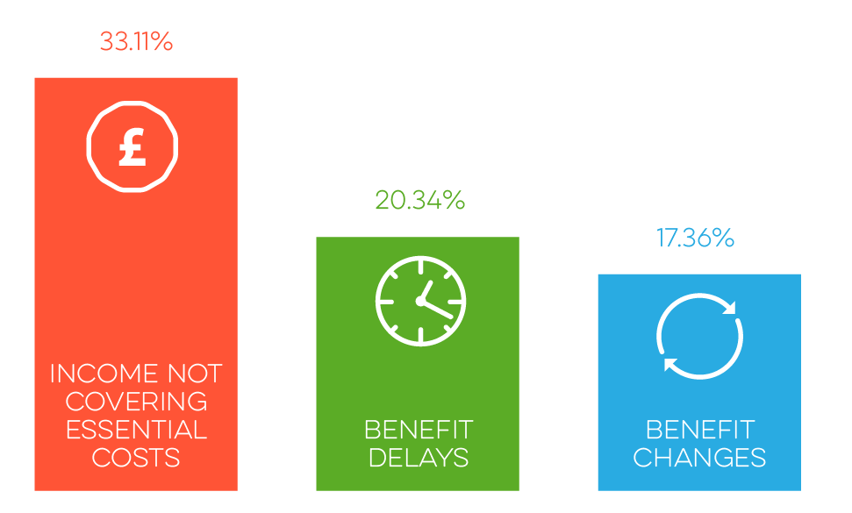
Key issues
Benefits
Cost of living
Primary reasons for referral to food banks in the Trussell Trust network in 2018 - 2019
In-work poverty
Notes:
More than a third of people referred to a Trussell Trust food bank last year were referred because their income does not cover the cost of essentials. A further 20% were in crisis due to benefit delays, and 17% due to benefit changes.
Universal Credit is not the only benefit payment people referred to food banks experience problems with, but it is a key driver behind increased food bank use. A big problem with Universal Credit is that everyone who applies has to wait at least five weeks for a full payment - with some waiting even longer. This is leaving many people without enough money to cover the basics. Even when they receive their payments, for many this does not cover the cost of living - just 8% of people surveyed at food banks in the Trussell Trust’s network said that their full Universal Credit payment met their living costs.
The benefits freeze and cuts to local welfare are also having an impact. The cost of living is rising, particularly for housing, but benefits are not keeping up and people’s income simply does not cover the costs they need to meet. For people in work, many are finding that low-paid and insecure jobs aren’t paying the bills - four million people in work are also living in poverty.

Slide 11
compassion
dignity
justice
community
Notes:
Explain that we’ve been through a process of reflecting on our values, and on the Christian principles that underpin our work, and that we’ve asked our staff and volunteers to contribute to this.
Ask people to guess what they think some of our values might be, based on what they’ve just heard….
Then share that these are the values that seem to come out most strongly as being important within our food bank network and our core team…
But putting values into practice isn’t always straightforward or easy is it?

Slide 12
what
Principles into action
why
how
Notes:
Explain my background in research. When I was training I heard a talk by someone who was both an academic and a Christian, about how their Christian faith influenced their work. Being an academic, they of course had a theory, a model, for this, which I found quite helpful. It’s a very simple model, which is probably why it was memorable, but also I think simple ideas can often be the most powerful.
He said that he sought for his faith to influence what he did – he was studying French philosophers – how he did it– not just in terms of taking an ethical approach to doing research, but also in terms of kinds of relationships he built with his colleagues and students, and why he did it – so that he was being formed and informed by his faith when it came to his motivations, purpose and self-understanding of what he was doing. And I’ve found that this is a model that is just as relevant to food banks as it is to philosophy. And importantly it’s also a model that works for people who are not Christians – the Trussell Trust is an organisation based on Christian principles, lots of our food banks are based in churches, and many of our volunteers are Christians. But we’re also really pleased that food banks are a context in which people who are of no particular religious faith, people from many different Christian denominations and backgrounds, and people of other faiths come together to make a difference in their communities. And so although I’m going to talk in a moment about some of the ‘whys’ that the Christian faith gives us that motivate and guide our work, it’s important to recognise that the shared values that we have can also be supported by other ‘whys’ rooted in different belief systems, and our ability to agree on the values we share is what enables us to work together for the common good. And I think you’ll agree that given the size of the problem of UK poverty that we’ve talked about earlier, building partnerships across sectors, and within our communities is really important.
So what I want to do now is offer some reflections on the why, the what and the how of these values that are emerging from our food bank network. As I do, I want to be clear that, for all of us I think, putting values into practice is a challenging thing. It isn’t something we get 100% right first time. Often we make mistakes, we try one thing and learn from it and then try it a different way. And this would be true for us as an organisation too, some of our values highlight areas that we can grow in. For example justice – our policy and research team has grown substantially in the last 2 years to help us rise to the challenge of seeking justice for those affected by the issues we see in our food banks at a local level.

Slide 13
Compassion
‘The meaning of compassion is to recognize the suffering of others and then take action to help. Compassion embodies a tangible expression of love for those who are suffering.’
‘The Lord is gracious and righteous;
our God is full of compassion.’ —Psalm 116:5
Notes:
Compassion has been defined as….
In the Old Testament we frequently see compassion appear as a characteristic of God…

Slide 14
Compassion
‘When Jesus landed and saw a large crowd, he had compassion on them, because they were like sheep without a shepherd. So he began teaching them many things.’ — Mark 6:34
‘Therefore, as God’s chosen people, holy and dearly loved, clothe yourselves with compassion, kindness, humility, gentleness and patience.’ — Colossians 3:12
Notes:
And the Gospel accounts of the life of Jesus also use the word compassion to describe the way he responds to people. And it’s interesting that his compassion is worked out in different kinds of actions at different times, so in this account from Mark’s gospel, Jesus has compassion for a crowd, and his response, his way of helping them, is to teach them many things. In Matthew’s gospel we read a similar account of Jesus’ interaction with a large crowd where his compassion leads him to heal many people there.
And then, as we think about how this applies to our own lives, we see that followers of Jesus are to take on the same characteristics – ‘clothe yourselves with compassion, kindness, humility, gentleness and patience.’
Provision of emergency food for people in crisis
Welcome and listening ear
Signposting to other support
How: Making sure we’re actually helping
Quality of relationships
Engaging in other ways too
Care for our staff and volunteers

Slide 15
dignity
‘In virtue simply of our shared humanity, we must surely respect and honour one another. Each individual has a value that can never be lost and must never be ignored.’ — Cardinal Basil Hume
‘So God created humankind in his image, in the image of God he created them’
—Genesis 1:26-27
Notes:
There is an anthropological component to human dignity – what God tells us about the nature of humankind, but also a Christological one – about the way Christ shares in our humanity….

Slide 16
dignity
‘Just as you did it to one of the least of these who are members of my family, you did it to me.’ — Matthew 25:40
Notes:
Participation
We frequently see people who have used food banks themselves becoming volunteers or donating to food banks once they are back on their feet

Slide 17
“I sat in the car park for about ten minutes getting the courage to go in, but the welcome that I got was just phenomenal. I felt so at ease. I left the food bank with my bags of food and felt very overwhelmed. I was so glad I had come.”
Donna
Notes:
Client Quote
Donna: “It’s not just food - you’ve got to buy clothes now and then, washing powder and cleaning products. By the time you’ve bought all that and paid your bills you don’t have much left for food; you can’t live like that.”
https://www.trusselltrust.org/what-we-do/real-stories/donna/

Slide 18
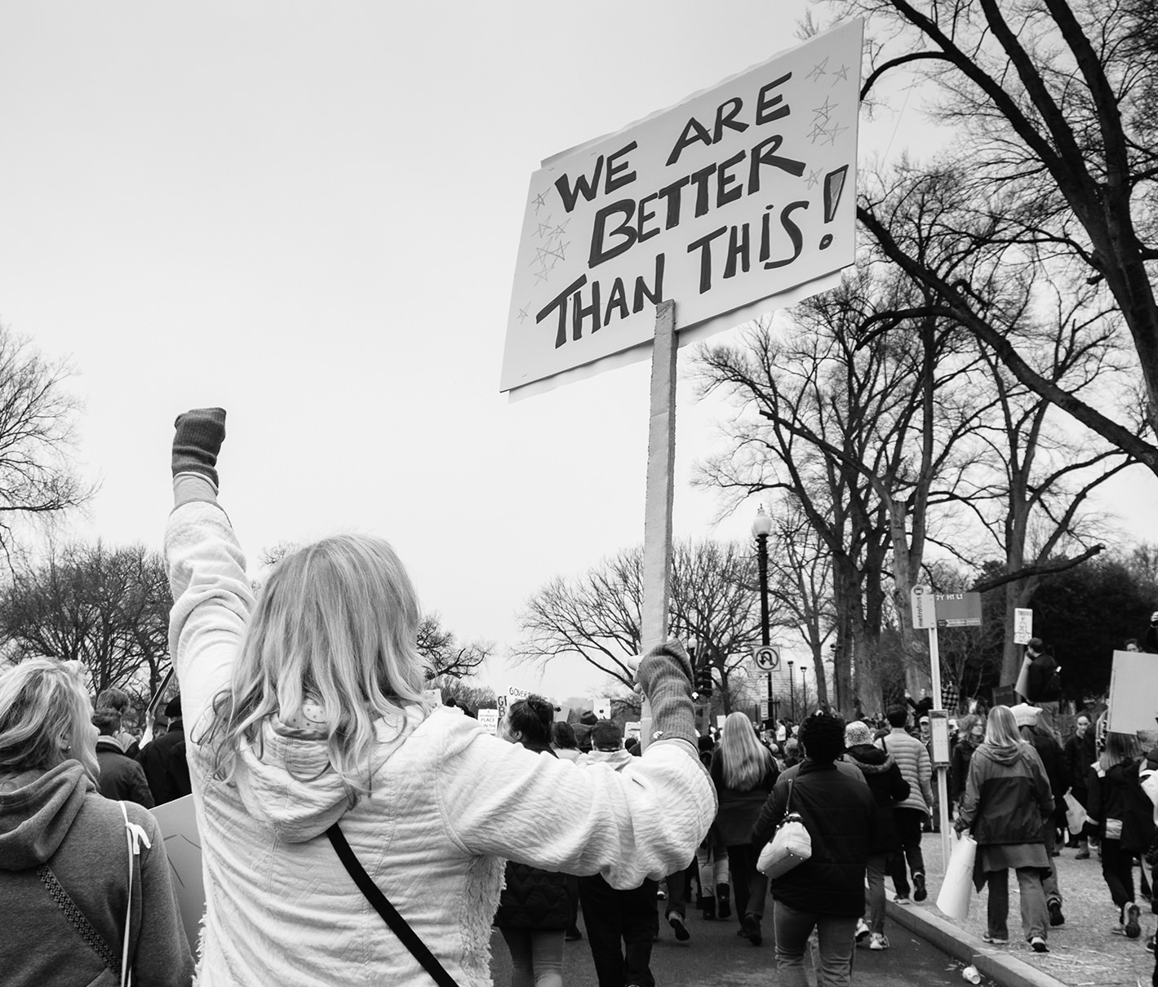
Justice
‘Is not this the kind of fasting I have chosen: to loose the chains of injustice and untie the cords of the yoke, to set the oppressed free and break every yoke?’ – Isaiah 58:6
‘The hope of the poor will not perish for ever.’ – Psalm 9:19
Notes:
Recognition that for each of us, our wellbeing is affected by social and economic structures that are beyond our individual control. So we need to seek to influence those structures, where they are preventing people from experiencing fullness of live. Inequality.
Return to the verse from Psalm 9 highlighted in Pope Francis’ message for the World Day of the Poor – ‘the hope of the poor will not perish for ever’, or another translation reads: ‘the hopes of the poor will not always be crushed’. if we want to be part of building God’s kingdom, alleviating the suffering experienced by people living in poverty, and seeing them find ways out of poverty, it means challenging structural injustices as well as showing compassion in an inter-personal way. And for us at Trussell Trust, this ‘justice’ aspect is absolutely key to our goal of ending the need for food banks in the UK. It isn’t right that problems with the benefits system are causing people to go hungry or pushing them into debt. It isn’t right that people are working and yet find that their wages are insufficient to meet their houselhold’s essential living costs.
Expertise is part of this – research, evidence, work with govt etc.
But there are other ways to get involved too – 5 weeks too long campaign, online petition, writing to MP, meeting with MPs

Slide 19
Community
‘True relationship implies helping others to discover who they truly are, respected and loved in their deepest person and called to rise up as they are to find their place in the world or in the Church’ – Jean Vanier
‘A new command I give you: Love one another. As I have loved you, so you must love one another. By this everyone will know that you are my disciples, if you love one another.’ – John 13:34-35
Notes:
If we want our local communities to be places where people aren’t falling through the gaps, we need to know one another, we need to be in relationship with one another.
One of the things we’ve seen happening through the food bank network is that people have become aware of the very different circumstances that people in their local area might be facing.
Pope Francis’ message says: ‘In closeness to the poor, the Church comes to realize that she is one people, spread throughout many nations and called to ensure that no one feels a stranger or outcast,’ I think this is something that many of our volunteers would say that they have begun to grasp, through the time they’ve spent with people in food banks.
But there is more to do, of course. One of the things that we’re already giving thought to is how can we make sure that we leave a legacy in local communities that sustains and deepens this connectedness – that brings people from different walks of life together, not because they need food, but because they want to share food – and time – together. Because they want to look out for one another, and have a sense of belong to one another and to a community that is bigger than themselves.
What we are doing: A locally based provider, relying on volunteers, local people to make it happen.
How: seeking to be relational in what we’re doing…

Slide 20
what
Principles into action
why
how
Notes:
So I hope that what I’ve shared will have given you some food for thought, whether in relation to things that you’re already involved in in your own churches or communities, or whether it’s sparked some ideas about new things that you might start or get involved in

Slide 21
Pray volunteer donate campaign
www.trusselltrust.org
Notes:
I hope that what I’ve shared will have given you some food for thought, whether in relation to things that you’re already involved in in your own churches or communities, or whether it’s sparked some ideas about new things that you might start or get involved in. If you’re interested in exploring ways that you can support our work and help us move towards the goal of ending the need for food banks in the UK these are some of the ways we would love you to get involved, and you can find out more on our website or come and talk to me afterwards.

