Slide 1
The Hope of the Poor
12 October 2019

Slide 2
Canon John Deeny Vicar General Chair of the Caritas Committee

Slide 3
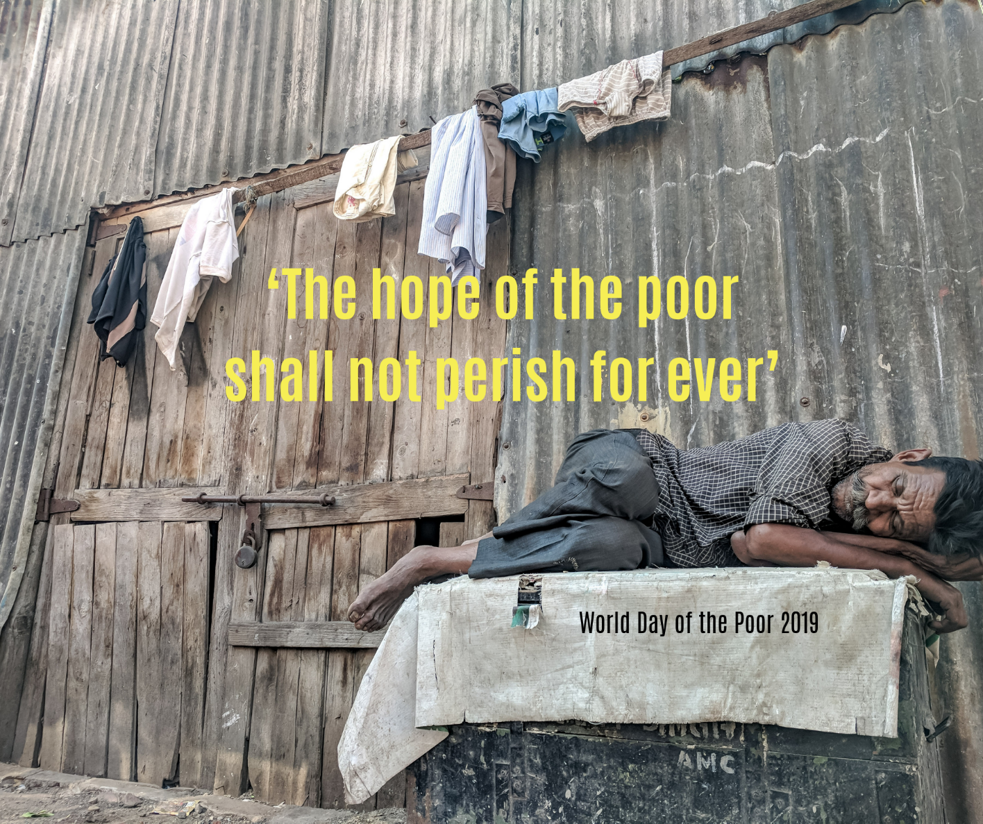
Welcome

Slide 4
Pope Francis’ message for the World Day of the Poor 2019
‘The Hope of the Poor shall not perish for ever’

Slide 6
Lazarus & Dives

Slide 8
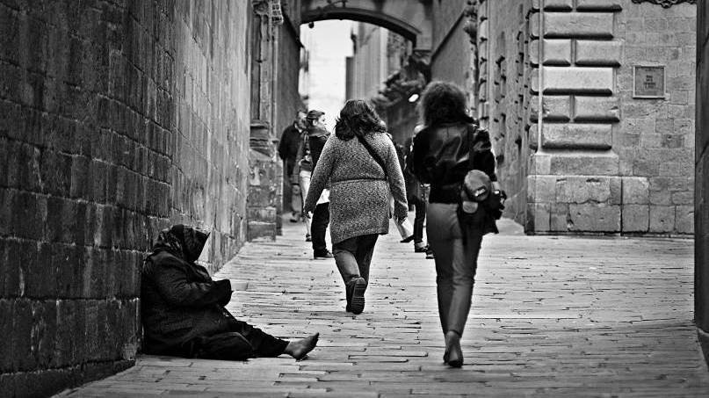

Slide 9
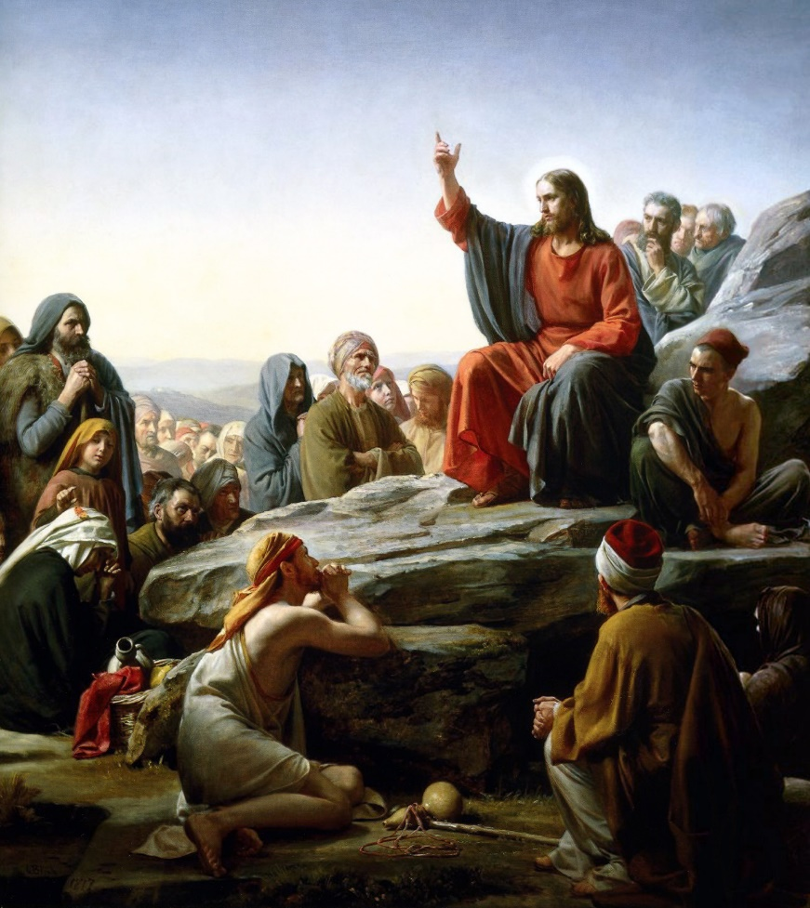
Scripture speaks of God acting on behalf of the poor

Slide 10
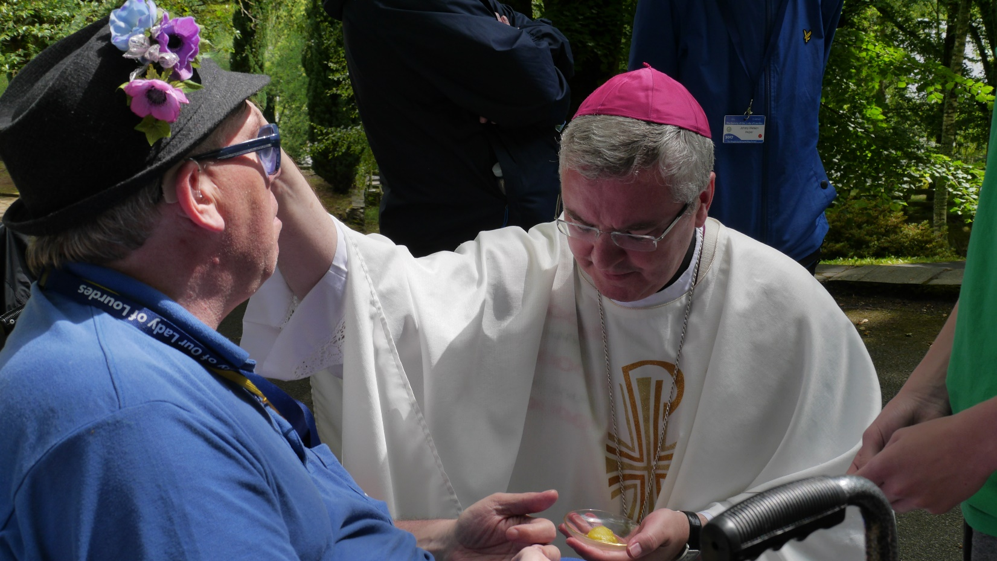
The Church – called to touch the flesh of Christ

Slide 11
Christians called to constant commitment

Slide 12
Volunteers persevere in dedicated service

Slide 13
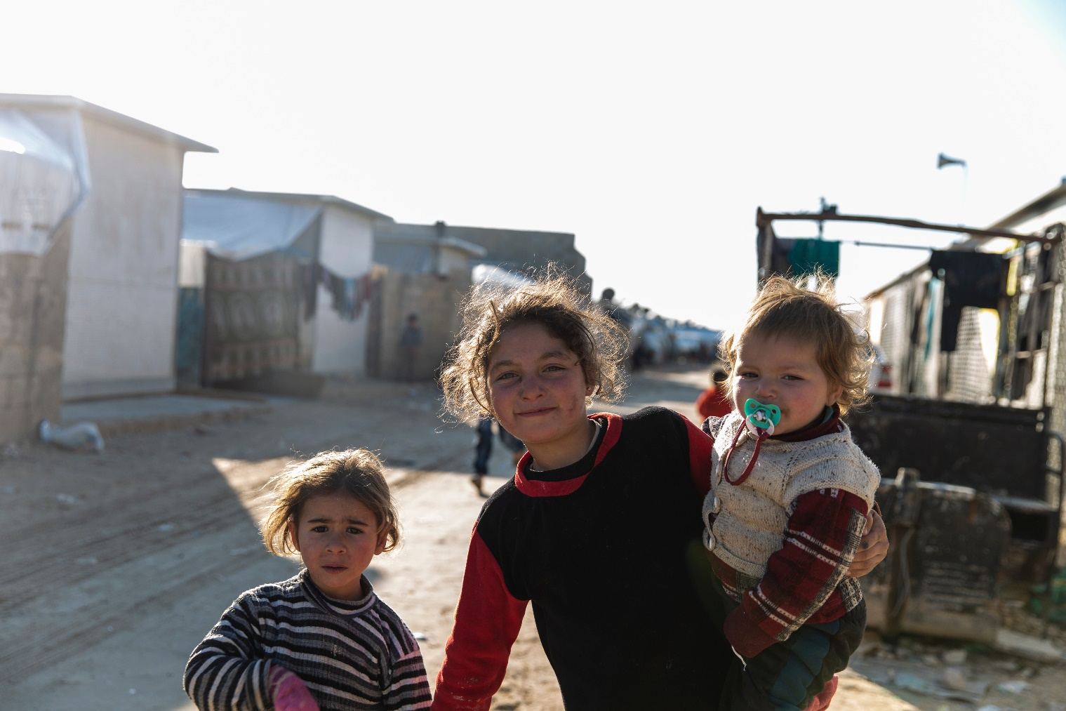
The Poor save us

Slide 14
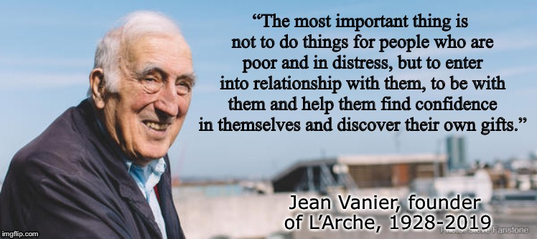
Reflections
The importance of encounter

Slide 15
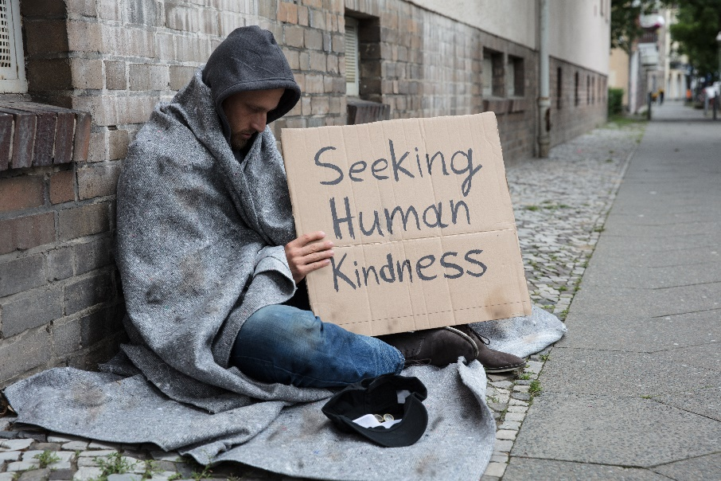
Reflections
“ I ask all Christian communities, and all those who feel impelled to offer hope and consolation to the poor, to help ensure that this World Day of the Poor will encourage more and more people to cooperate effectively so that no one will feel deprived of closeness and solidarity.”
Pope Francis

Slide 17
Lisa Howard Food Equality Champion

Slide 18
Niall Cooper Director Church Action on Poverty

Slide 19
Heather Buckingham Head of Church Engagement Trussell Trust

